Slide 1
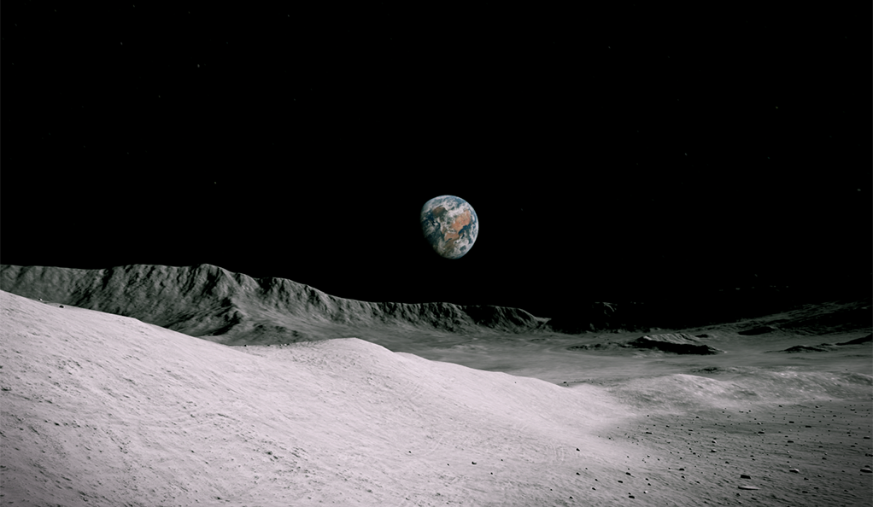
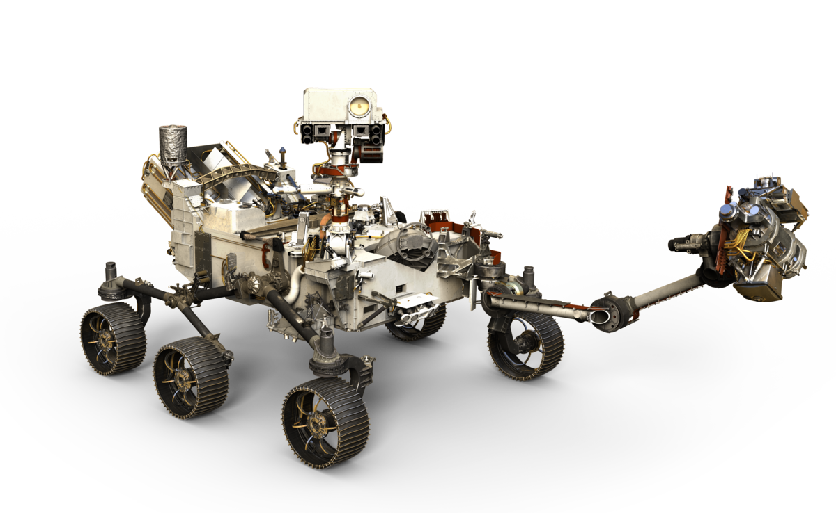
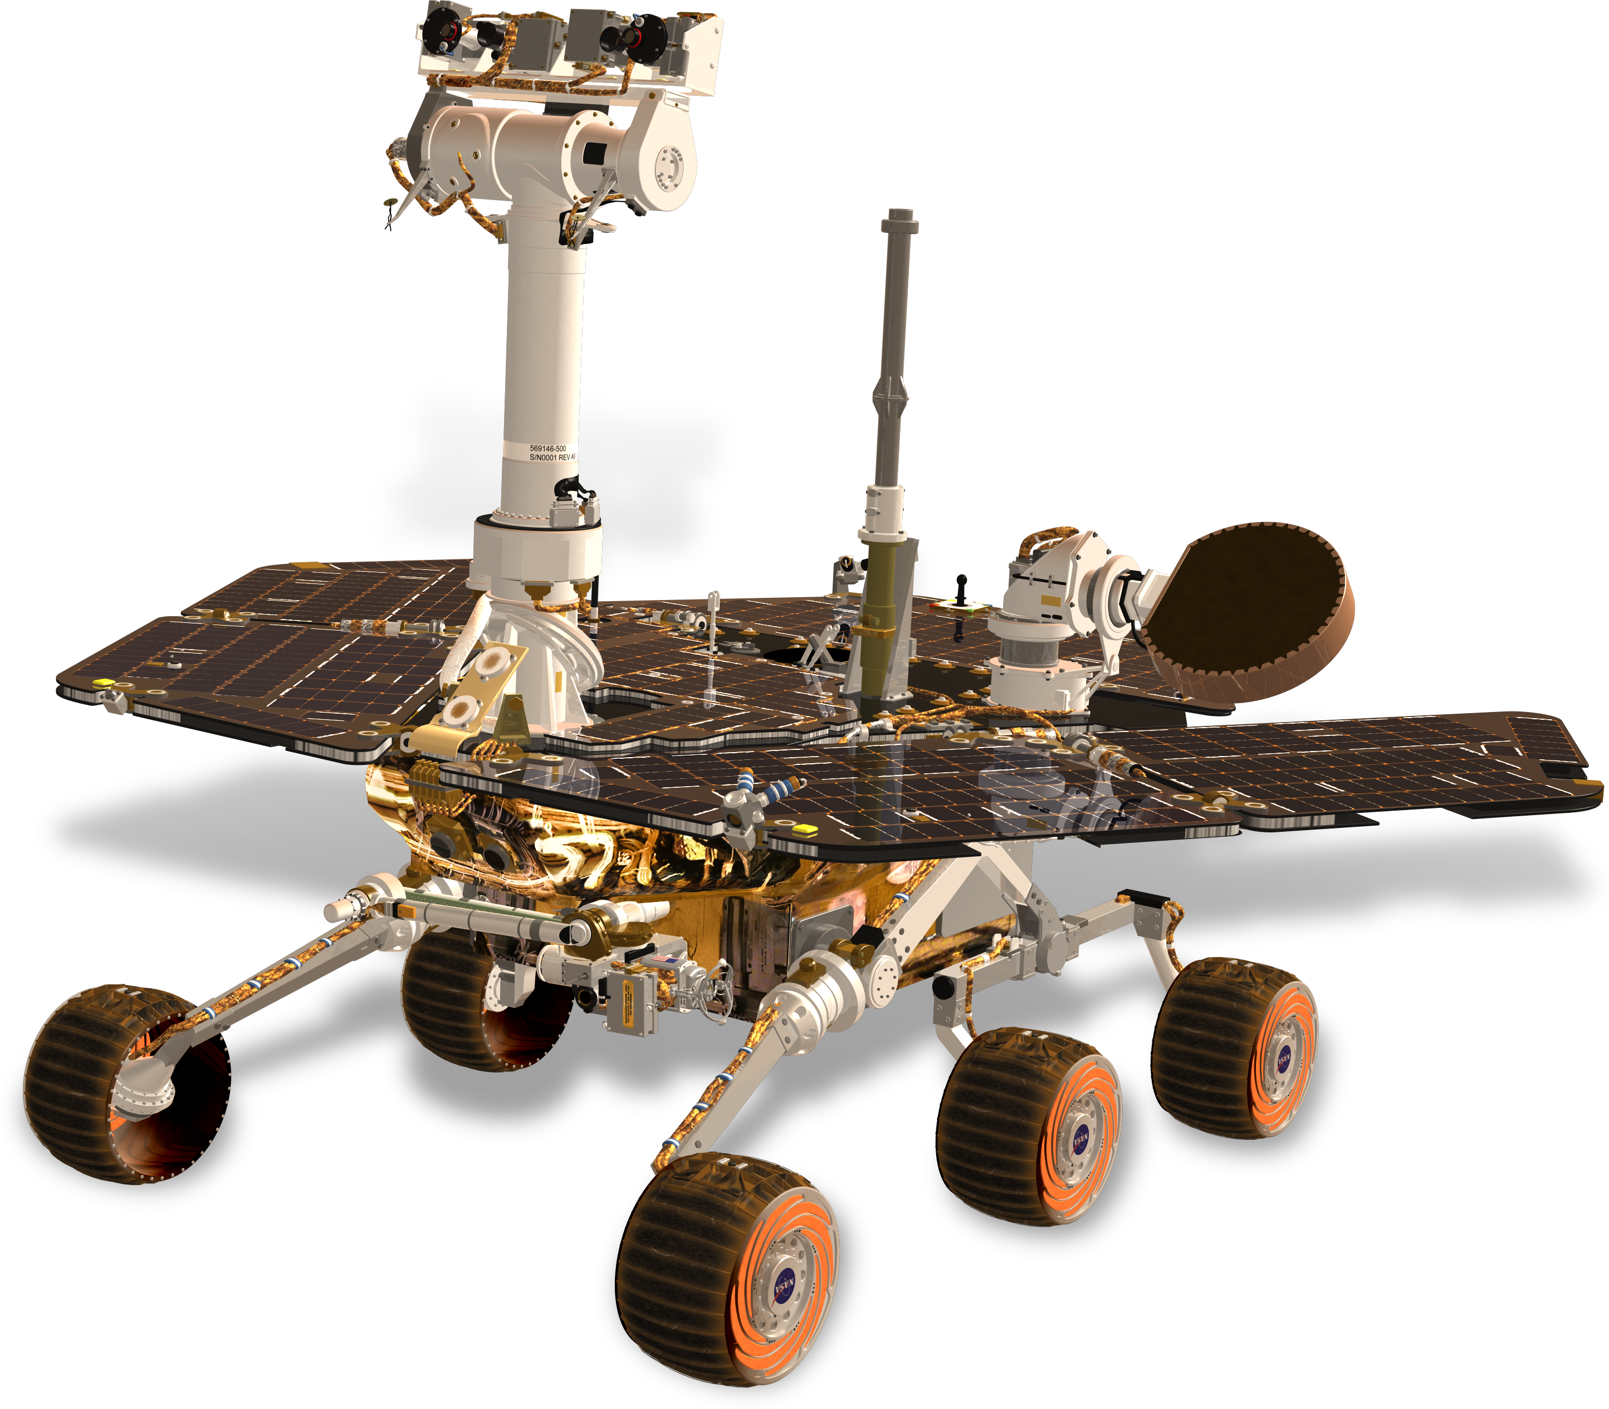
Team 517
Design Review 5
Cameron Barnes | Cole Gutknecht | Tyler Ince-Ingram| Rafael Meza | Michael Wyrick
Notes:
Hi everyone, we are Senior Design Team 517 and we are presenting on our project progress so far this year

Slide 2





Team Overview
Cameron Barnes
Cole Gutknecht
Tyler Ince-Ingram
Rafael Meza
Michael Wyrick
Michael
Systems Engineer
Materials Engineer
Test Engineer
Dynamics Engineer
Design Engineer
Notes:
First we will start with some team introductions,

Slide 3


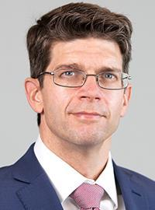
Sponsor and Advisor
Arthur Werkheiser
Dr. William Oates
Notes:
The sponsor for our project is Arthur Werkheiser, Deputy Branch Chief at Marshall Space Flight Center, acting as a liaison between our team and NASA. Our academic advisor is Dr. Oates who has research interests in Mechanics and Materials along with Non-linear control.

Slide 4
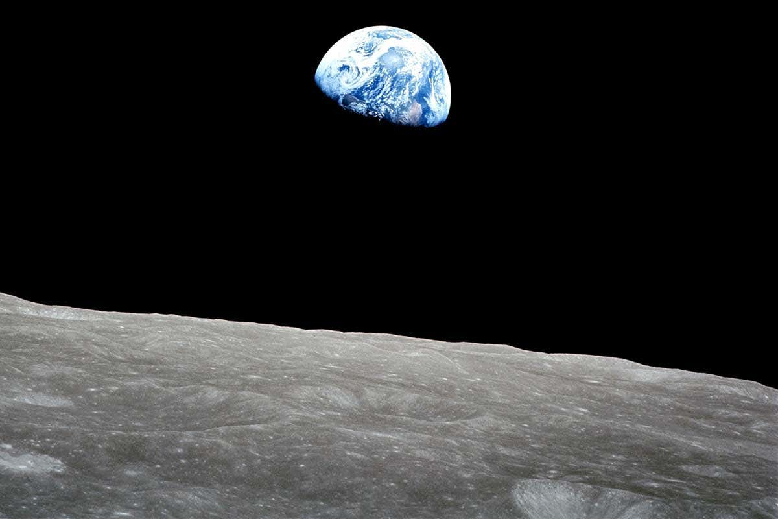
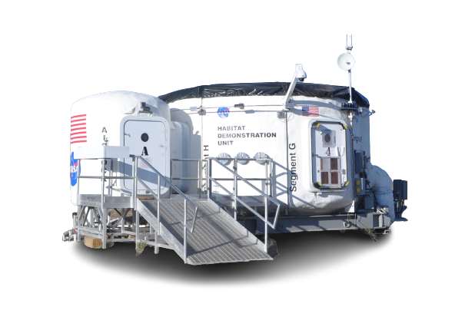
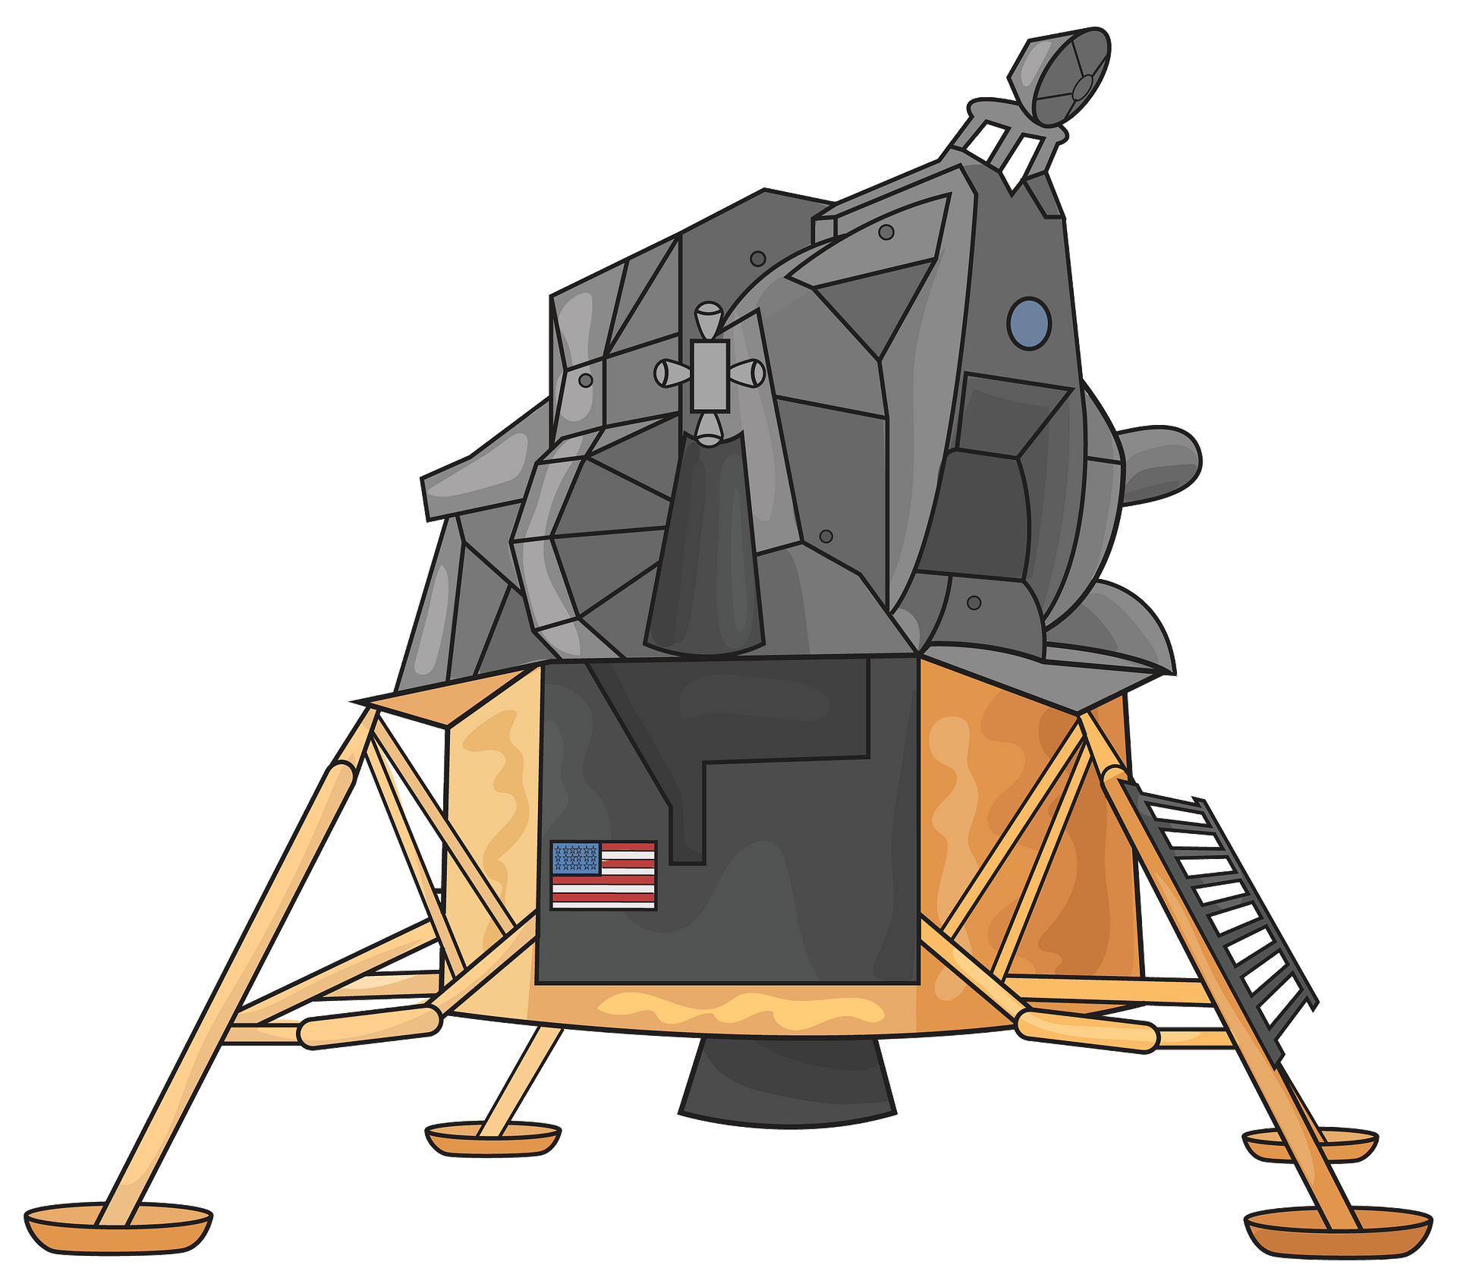
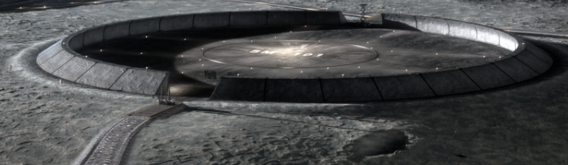
Project Description
Transport Heavy Loads on the Lunar Surface between the Landing Site and Habitation Area
Notes:
The objective of our project is to transport heavy loads on the lunar surface between an established landing site and habitation area.

Slide 5
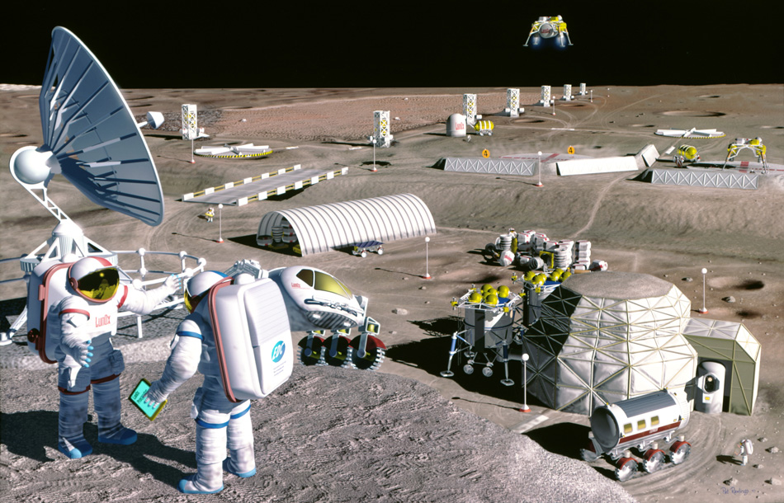

Background
Notes:
NASA’s Artemis project is the start of their plan for sustainable lunar development. The goal is that at some point in the future, we would have lunar bases and habitation areas acting as both scientific exploration centers and also a pitstop on the way to Mars. However, some sort of device will be needed to help transport cargo around these habitats and also unload cargo from the nearby landing site which is where our device would come in.

Slide 6



HERMES
ACRONYM:
Heavy Equipment Rover for lunar Mobility, Expansion, and Sustainment
SYMBOLISM:
God of Transportation Protector of Travelers
Notes:
Our team name for our design is Hermes. The name stands for Heavy Equipment Rover for lunar Mobility, Expansion, and Sustainment. In Greek mythology, Hermes was also the God of Transportation Protector of Travelers which is applicable to our design background.

Slide 7
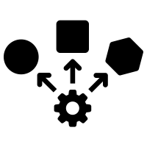




Key Goals
Lightweight
Adaptable
Safe
Robust
Lifespan
Notes:
The following items are key design goals for our product. It must be lightweight; this is because reduction in weight translates to lower costs of delivery to the moon which will make our design dost effective
It must be a robust design due to challenges surrounding the lunar environment and terrain, regolith and dust can be detrimental to the design if not adequately protected.
The design should have a level of adaptability so that other necessary components such as power and thermal management systems, can be built into the design in the future
The product should last at least one year on the moon to keep transportation costs low making it cost-effective and also to decrease the amount of lunar waste that would be produced from a short-term device.
The device should meet all NASA and United States safety and technical standards and produce a relatively low risk in chance of design failure

Slide 8





Assumptions
Max payload 1.4 metric tons on Earth
Standard packaging designed by team
Cost
effective
materials
Maximum distance of 1 km
Focus on mechanical design
Notes:
In order to make our design possible we had to make the following assumptions
1. The payload will have a maximum mass of 1.4 metric tons on Earth (Full Scale)
2. The materials purchased will be budget-friendly. The end product will be an earth-bound prototype and we will be buying materials suitable to this application.
3. The landing site of the aircraft should be within 1 km of the habitation area where the cargo will be deposited. ---Preferably our device could travel longer distances but it should at a minimum be able to travel this kilometer.
4. Standard packaging will be used on lunar missions and can designed according to the team
5. Certain systems necessary for a fully functioning lunar vehicle can be excluded for the sake of time management of the project. This includes fully functioning power, thermal management, tires/suspension system, and autonomy.

Slide 9




Targets and Metrics
Survivability
Activation
Structural
Design
Power
Notes:
Our main targets are power, activation, and structural design based on the functional decomposition of our device. After further consideration survivability falls into that previously discussed assumption and will not be a focus of our design.

Slide 10


Targets and Metrics
Convert power to movement
Achieves speed of 3.64 ft/s
Power
Notes:
Our main power target is that the device is capable of driving at least 4 km/hr

Slide 11


Targets and Metrics
Target and Metrics
Lift maximum weight
Lifts 308 pounds
Stability transporting over rough terrain
Activation
Transverses Inclines up to 20 degrees
Notes:
Our activation targets were designed to ensure our device can still lift, even in unideal situations
Our full-scale device will be expected to lift 1400 kg on earth, using a 1/10th scale, our prototype should successfully lift 257 pounds
Since the lunar surface is full of imperfections its important our device is capable of remaining stable on rocky terrain, a target is that it able to transverse an incline up to 20 degrees

Slide 12
Targets and Metrics
Targets and Metrics
Fit within Rocket
Scaled dimensions less than 24 x 29 x 49 in
Ground Clearance
At least 6 inches of ground clearance
Structural
Design
Structure Weight
No more than 175 lbs
Notes:
The main targets for our structural body are as follows:
Our full-scale device would have to fit in a rocket cargo bay. The target was based on data from the Space X Starship which determines our scaled device should be no more than 24 x 29 x 49 inches
In our order for our device to function correctly and transverse the lunar terrain, we have determined a ground clearance greater than 6 inches
The scaled weight our design should be less than 175 lbs. This would only include the weight of the structural body as the wheels we currently have on our design would not be applicable in space and are not scaled accordingly. Essentially its expected the deive will weigh half of what it can lift

Slide 13


Concept Generation
5 Medium Fidelity
100
Concepts
3 High Fidelity

Slide 14






Medium Fidelity Overview
Bipedal
Forklift
Rear
Lift System
Snake
Fang Lift
Modular Cargo Bed
Honeycomb

Slide 15
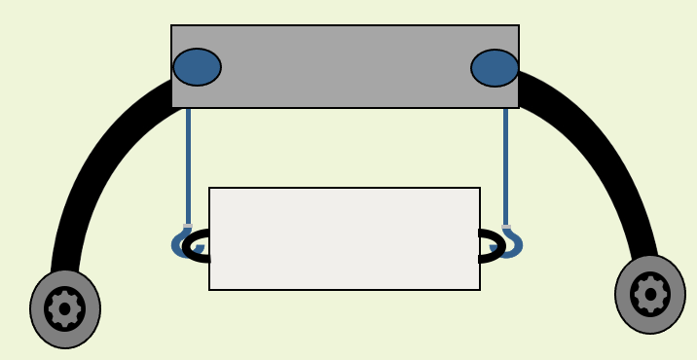
High Fidelity Overview
Seesaw
Assist System
Quadzilla
Assist System
Sunflower
Lift System

Slide 16




Concept Selection Overview
Binary Pairwise Comparison
House of Quality (HoQ)
Analytical Hierarchy Process (AHP)
Pugh Chart
Notes:
The team generated 100 ideas and from those narrowed our design to 5 medium fidelity and further into 3 high fidelity concepts. From these 3 high fidelty, it was determined through concept selection that the design ‘Quadzilla’ was the best fit for project objective.

Slide 17
Concept Selection Overview
House of Quality (HoQ)
Analytical Hierarchy Process (AHP)
Pugh Chart
Notes:
The team generated 100 ideas and from those narrowed our design to 5 medium fidelity and further into 3 high fidelity concepts. From these 3 high fidelty, it was determined through concept selection that the design ‘Quadzilla’ was the best fit for project objective.

Slide 18
Concept Selection Overview
Analytical Hierarchy Process (AHP)
Pugh Chart
Notes:
The team generated 100 ideas and from those narrowed our design to 5 medium fidelity and further into 3 high fidelity concepts. From these 3 high fidelty, it was determined through concept selection that the design ‘Quadzilla’ was the best fit for project objective.

Slide 19
Concept Selection Overview
Analytical Hierarchy Process (AHP)
Notes:
The team generated 100 ideas and from those narrowed our design to 5 medium fidelity and further into 3 high fidelity concepts. From these 3 high fidelty, it was determined through concept selection that the design ‘Quadzilla’ was the best fit for project objective.

Slide 20
Concept Selection Overview
Notes:
The team generated 100 ideas and from those narrowed our design to 5 medium fidelity and further into 3 high fidelity concepts. From these 3 high fidelty, it was determined through concept selection that the design ‘Quadzilla’ was the best fit for project objective.

Slide 21
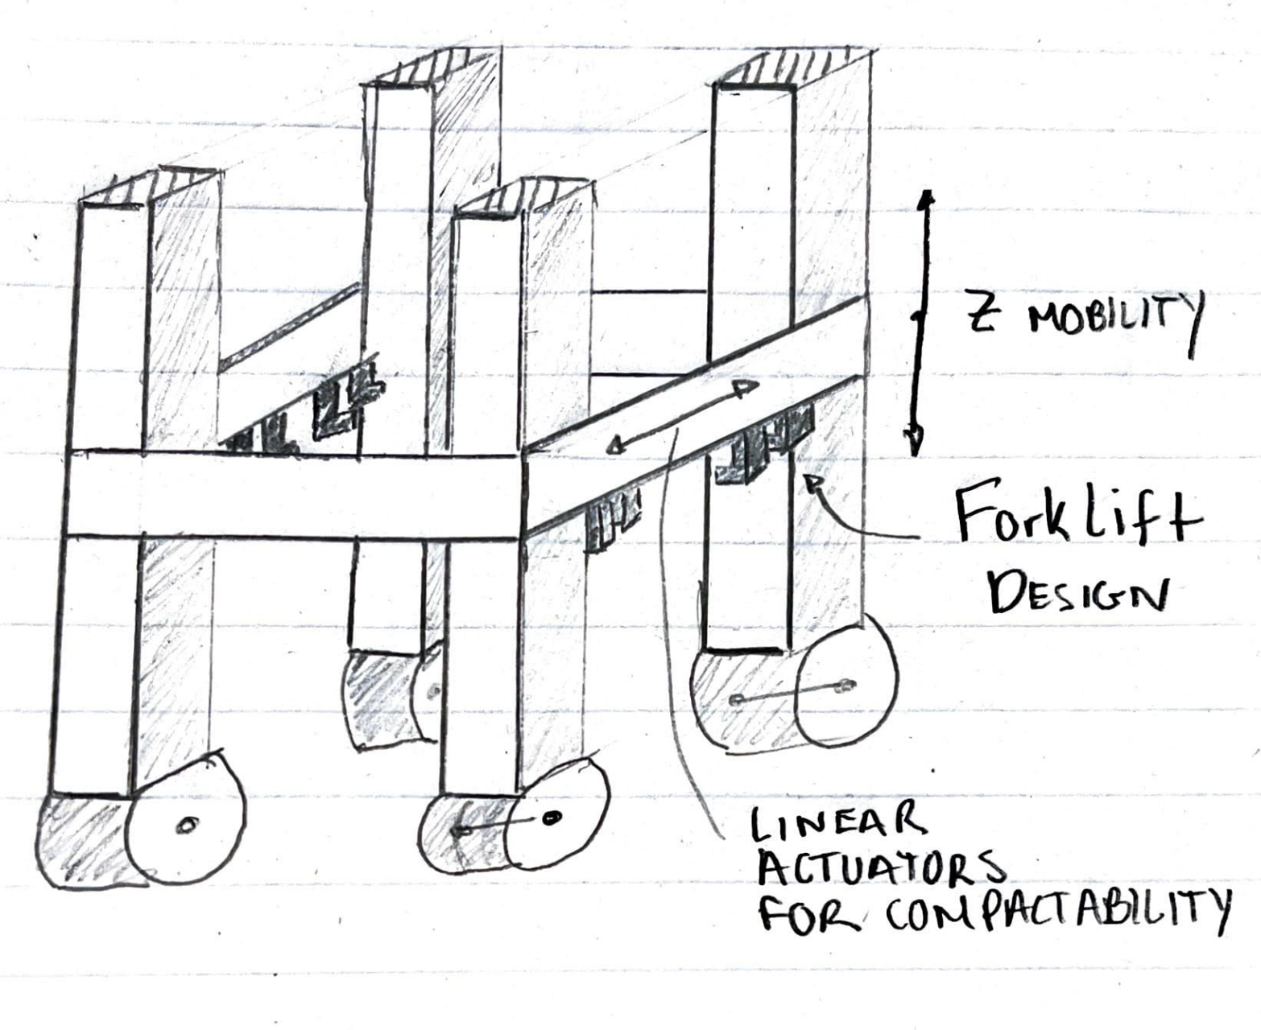
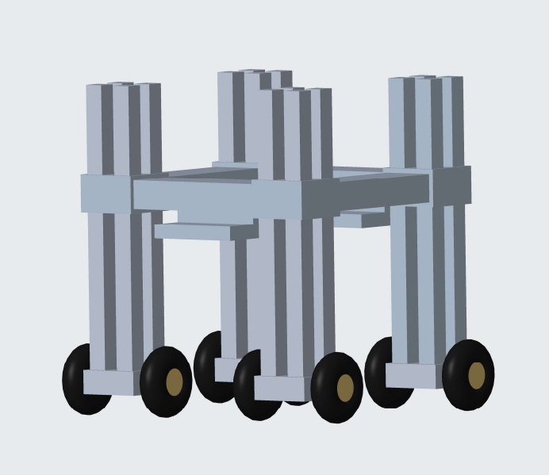
Initial Design
QUADZILLA
Notes:
Here is the initial design of quadzilla that was shown last semester. Although it shares many important qualities with our current design, it has some key differences including a fully enclosed platform with 4 free standing pillars and 8-wheel design . However, we modified this design to be more successful based on our needs

Slide 22


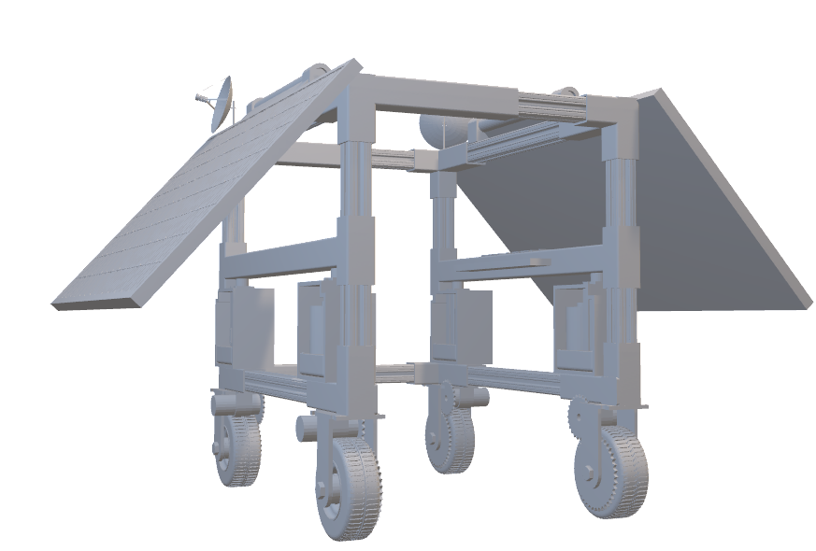
Current Design
Structural Frame
Aluminum X-beam Structure
Carbon Steel Corner Brackets
Telescoping Channels
Base Adaptability
Notes:
We broke up our current design into various subsystems to showcase its functionality.. Here with our structural frame it is made up mostly aluminum x beams acting as the 4 pillars and we chose this material due to it’s light weight to reduce the overall device weight. Channels were implemented on the back end of the device to compact it approximately 3 inches to fit within the constraints of the rocket and reduce it’s overall volume. The benefits to this structural frame is that it can be easily adapted to the lunar model by attaching solar panels and housing them on either the roof or side of the device. Other mechatronic components could be stored above as well to aid with other applications.

Slide 23
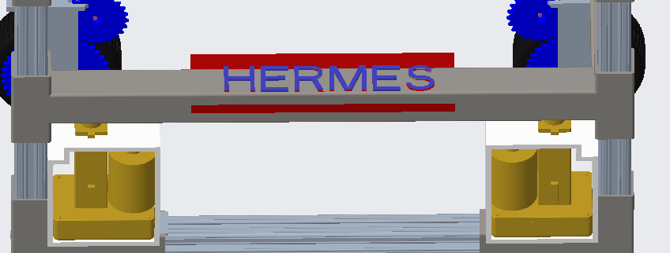
Current Design
Corner Connections
Sleeves around
X-beams
Highly stress resistant
Teflon Inserts
Notes:
Our corner connections ensure the load is stable and supported. Like I mentioned, these will be made of hollow steel that wraps around the x beams. Initially, as a team we were looking at plastic brackets however we decided that they would fail under the amount of force being exerted on them. So we decided to move froward with the metal brackets. Tephlon inserts will also be included to reduce surface friction.
Arrow to zoomed in

Slide 24
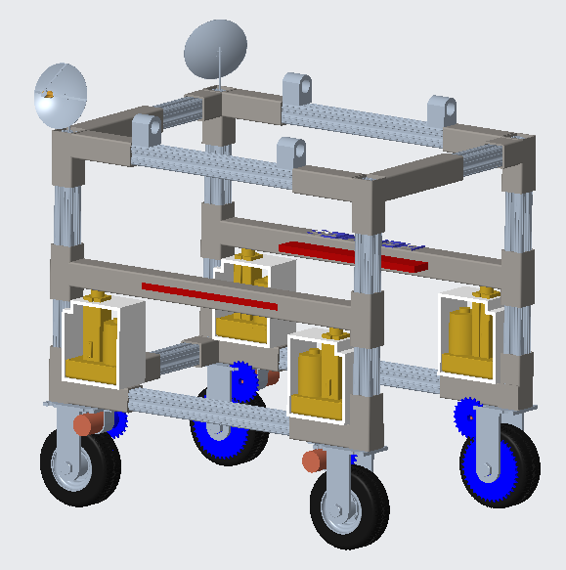
Current Design
Vertical Mobility
4 Linear Actuators
4-inch stroke to lift platform
Supports 75 lbs per actuator
Housing manufactured
Notes:
4 linear actuators with a 4 inch stroke, will be used and placed on each corner of the platform to raise the platform 4 inches. The load capacity of the actuators will be sufficient enough since the weight would be 75 lbs per actuator. An actuator housing will be designed and manufactured by the machine shop.

Slide 25
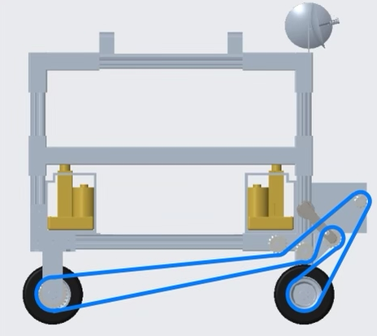
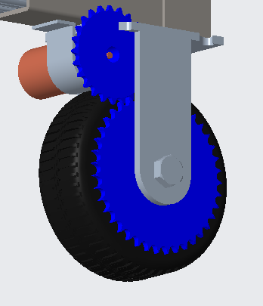
Design Iterations
Wheel and Motor
Initial
Modification
Notes:
The wheel coupling design was chosen to remove the need for individual motors at each wheel. To do skid steering the vehicle simply needs two motors which can drive in opposite directions. The drive system is done in halves, with the left front and back wheels being coupled, same with the right half. The coupling design uses a chain to connect the two wheels with sprockets at the axel to a V shaped path with a belt tensioner and a idler gear to guide the movement. Front and back wheels will not be in line because of the 2-1 design so we use a chain derailleur to position our components in line. A 3D printed casing for the mechanism is possible to prevent a chain slip.
The two back wheels will be driven by two remote controlled motors acting independently, the current idea is to incorporate a gear box system to implement an additional gear ratio to the axels using bevel gears like in the picture.

Slide 26
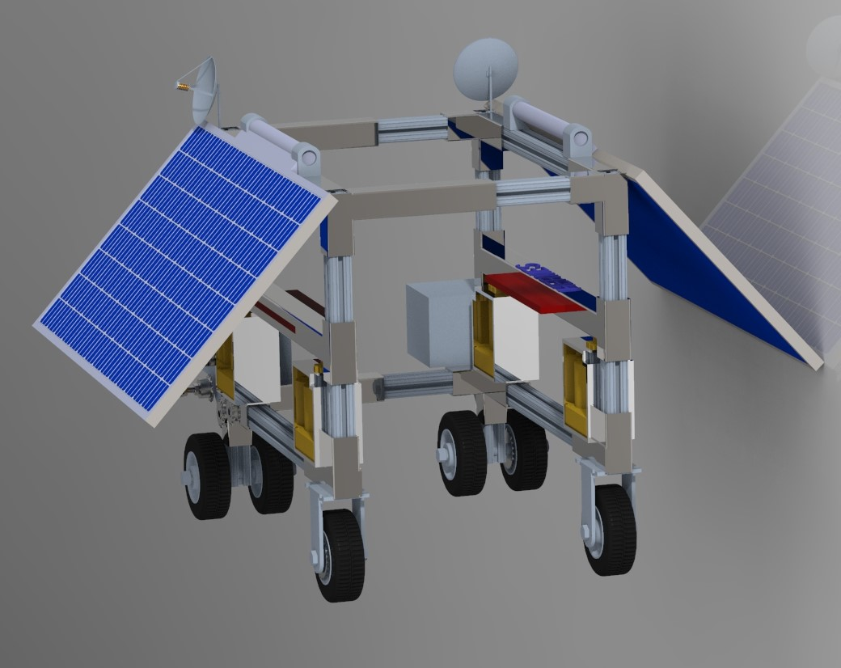
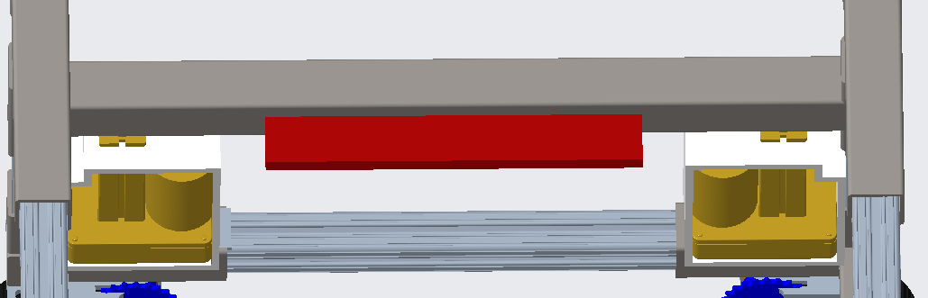

Platform Design
Platform
Picture of Full CAD
Notes:
The platform will be equipped with track wheels to ensure that the vertical motion is smooth with little to no friction. This design would not be ideal for the lunar concept and would need a casing to protect it from regolith. The track would wrap around the x beams and fit into the slots. The forks will be located on the platform and will be equipped with magnets throughout the platform to ensure the package locks into the correct position and to help with swaying. The package will be designed to have a slot where the forks can slide into and lock into place with the use of the magnets. Lock and key mechanism.

Slide 27
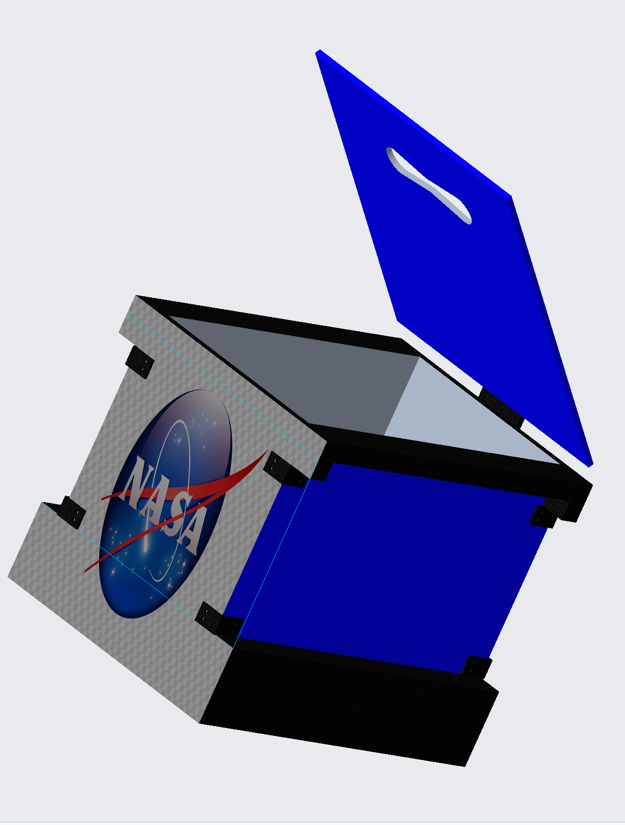
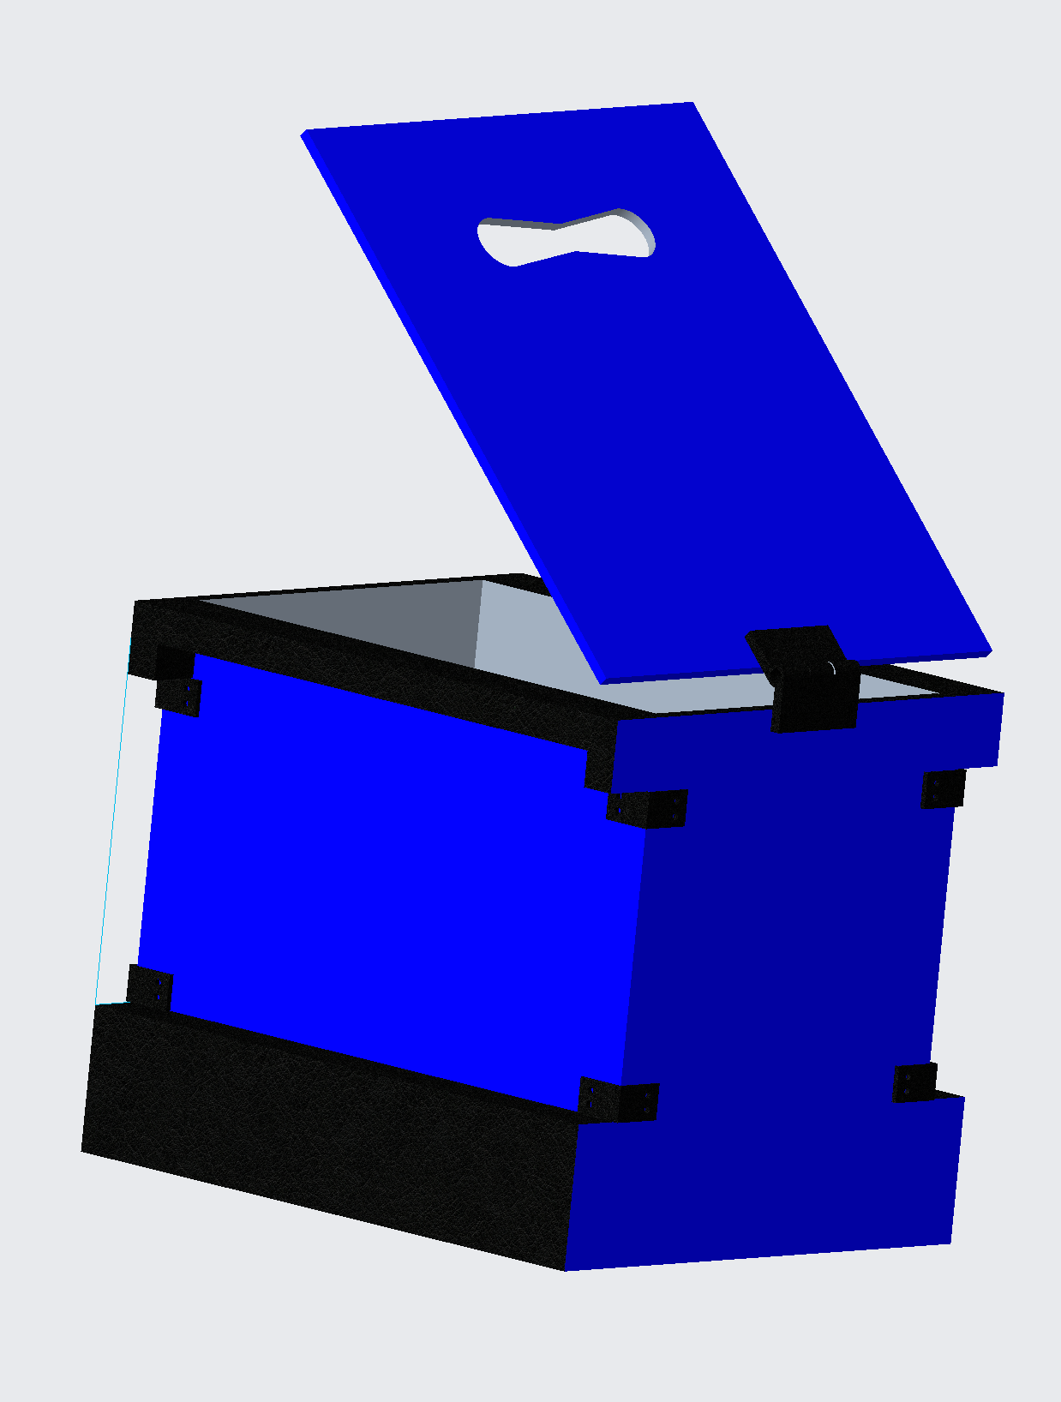
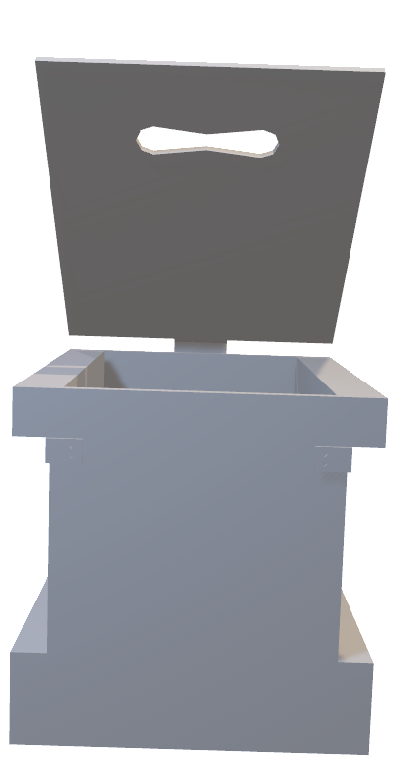
Package Design
Notes:
The platform will be equipped with track wheels to ensure that the vertical motion is smooth with little to no friction. This design would not be ideal for the lunar concept and would need a casing to protect it from regolith. The track would wrap around the x beams and fit into the slots. The forks will be located on the platform and will be equipped with magnets throughout the platform to ensure the package locks into the correct position and to help with swaying. The package will be designed to have a slot where the forks can slide into and lock into place with the use of the magnets. Lock and key mechanism.

Slide 28
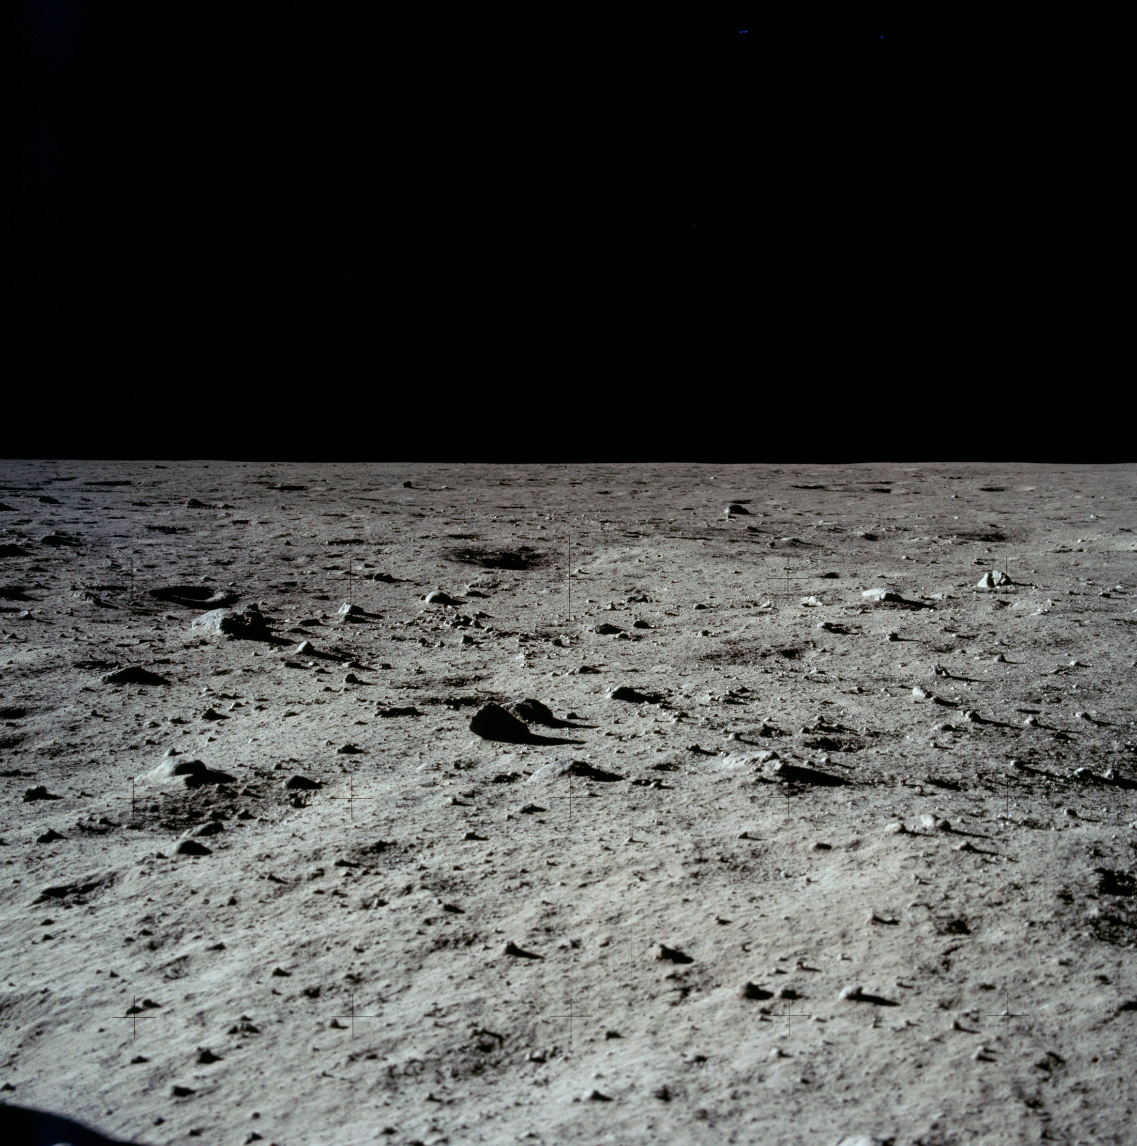
Operation
Notes:
Ride up

Slide 29
Operation
Notes:
Lift up a couple inches, lock into packaging, enough for ground clearance

Slide 30
Operation
Notes:
Transport (Fix this)

Slide 31



Design Benefits
Stable Design
Greatly Reduces its Volumetric Footprint
Low device weight, high lift capability
HERMES
Adaptable
Notes:
HERMES comes with a series of benefits such as; stable design (4 pillar x beam structure and the design being longer rather than taller, similar to a rectangle), is able to reduce its volumetric footprint through the use of the channels on the back of the device to collapse approximately 3 inches which would be about 3 feet in our true model, it features a low device weight due to the materials used along with it’s high lift capability of 330 lbs, the adaptability aspect comes into play where the top of the structure can be used to house solar panels or other electrical components that would be needed on the lunar surface.

Slide 32
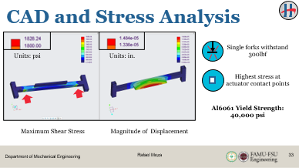
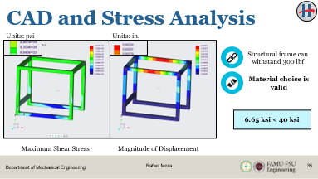
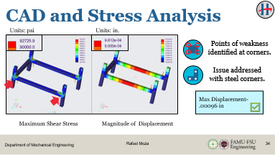
CAD and Stress Analysis
Platform
Bottom Structure
Top Structure
Notes:
Conducting Finite Element Analysis (FEA), we were able to see where the stresses would occur on just the structure itself by loading it at the top and then looking at the stresses that would be present when the forks on the platform are loaded. Due to the material properties of the platform the stresses it will undergo will not cause failure when lifting the cargo package. Specifically, we looked at the maximum shear stresses, and the displacement.

Slide 33
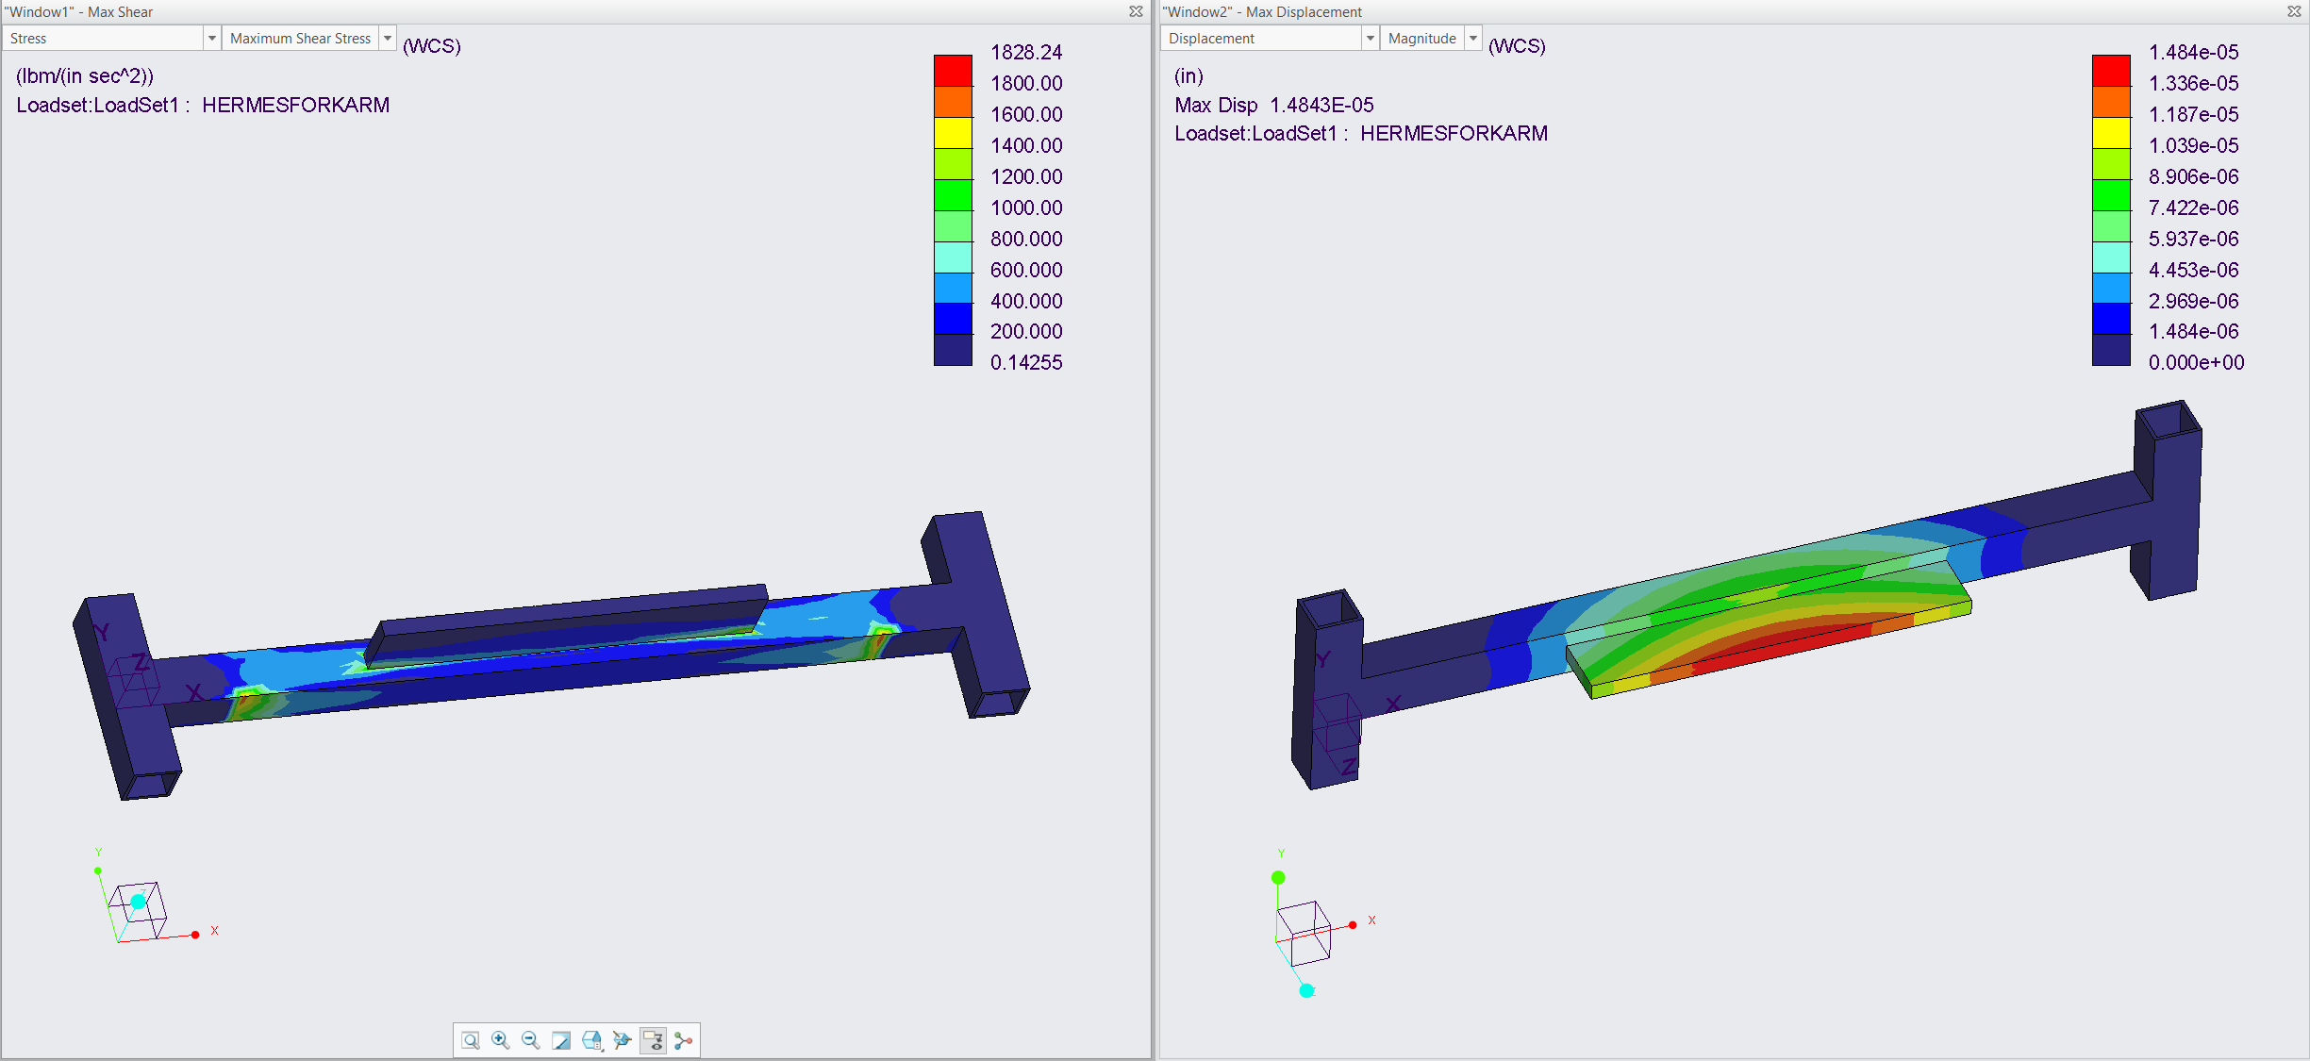
CAD and Stress Analysis
Single forks withstand 300lbf
Units: psi
Units: in.
Highest stress at actuator contact points
Al6061 Yield Strength:
40,000 psi
Maximum Shear Stress
Magnitude of Displacement
Notes:
Conducting Finite Element Analysis (FEA), we were able to see where the stresses would occur on just the structure itself by loading it at the top and then looking at the stresses that would be present when the forks on the platform are loaded. Due to the material properties of the platform the stresses it will undergo will not cause failure when lifting the cargo package. Specifically, we looked at the maximum shear stresses, and the displacement.

Slide 34
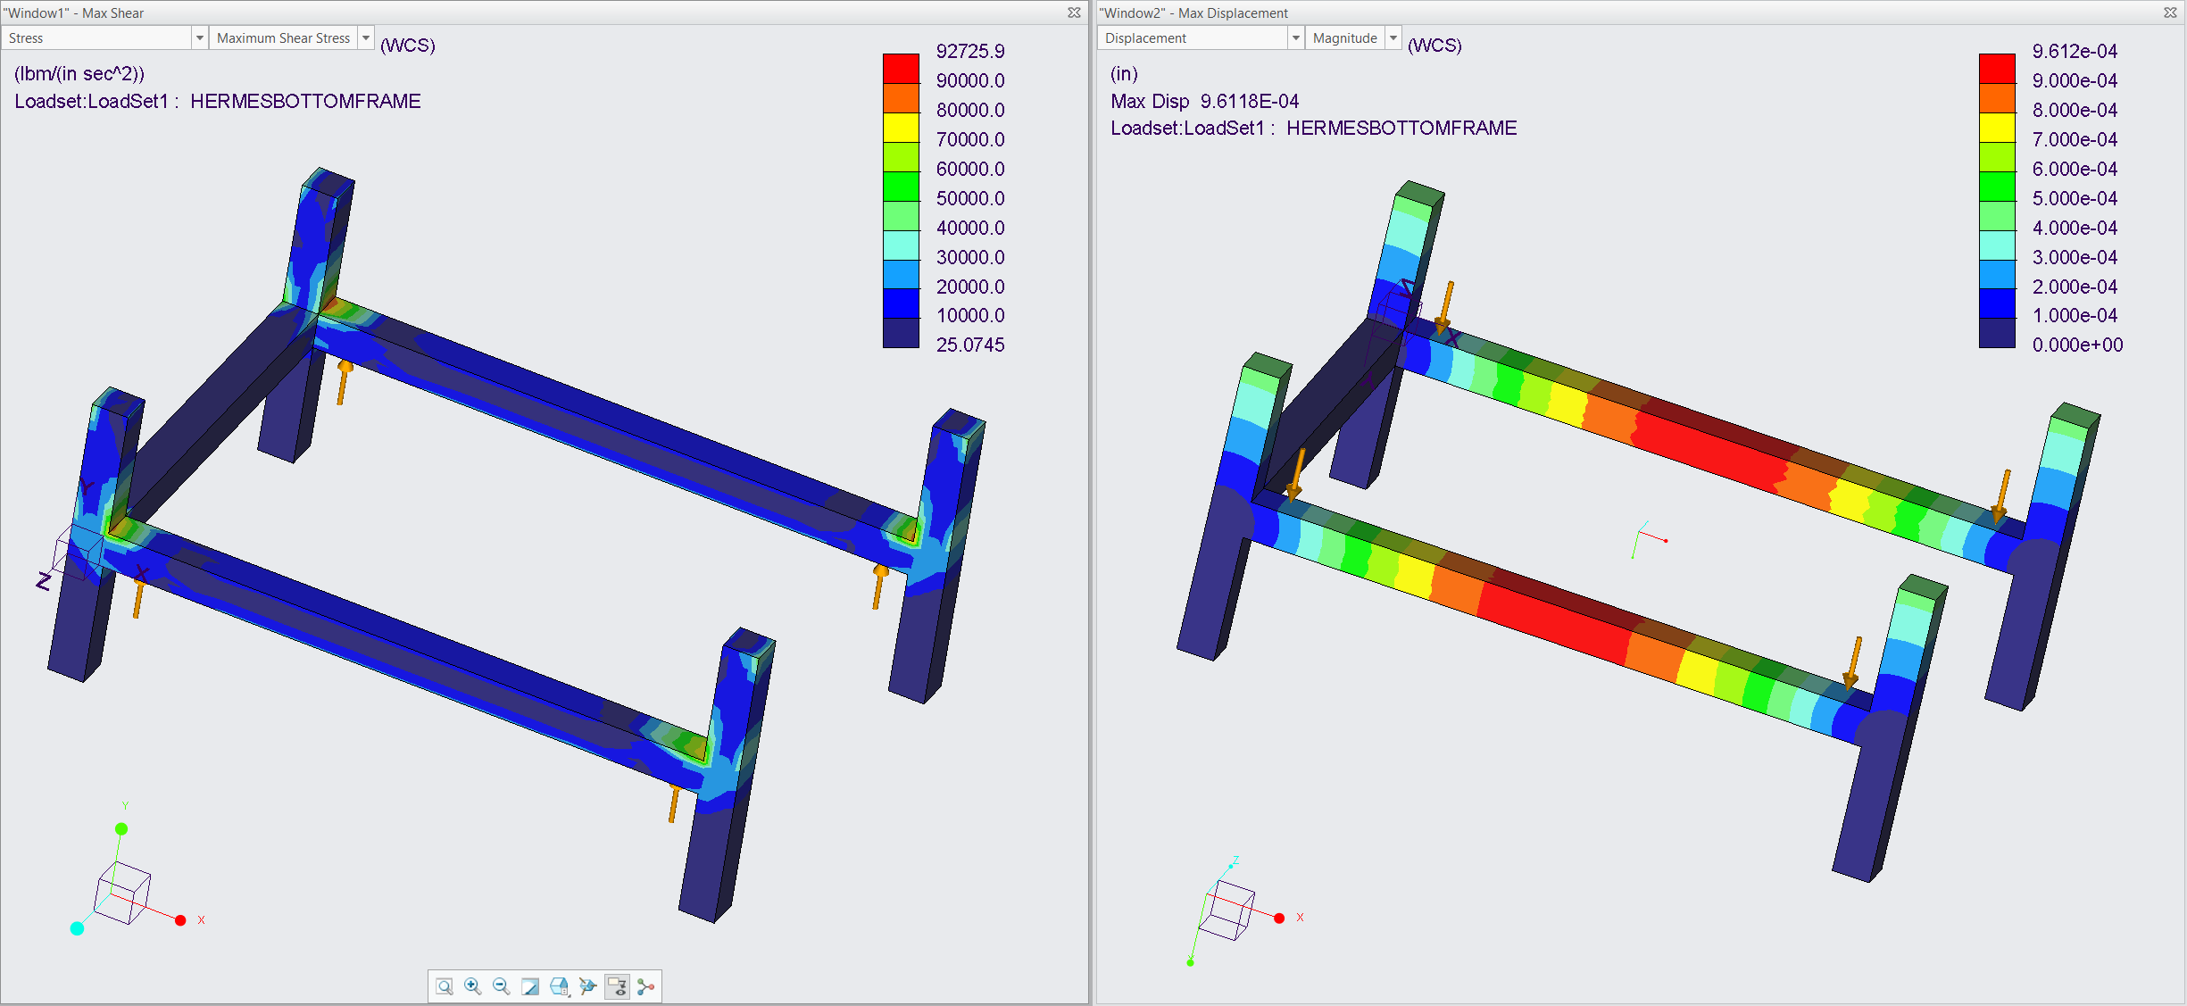

CAD and Stress Analysis
Units: psi
Units: in.
Points of weakness identified at corners.
Issue addressed with steel corners.
Max Displacement-
.00096 in
Maximum Shear Stress
Magnitude of Displacement
Notes:
Conducting Finite Element Analysis (FEA), we were able to see where the stresses would occur on just the structure itself by loading it at the top and then looking at the stresses that would be present when the forks on the platform are loaded. Due to the material properties of the platform the stresses it will undergo will not cause failure when lifting the cargo package. Specifically, we looked at the maximum shear stresses, and the displacement. On the bottom bar the shear stress is concentrated at the corners of the structure however this justifies the use of brackets coupled with the yield strength of the aluminum will suffice when experience the 300 lb load.

Slide 35
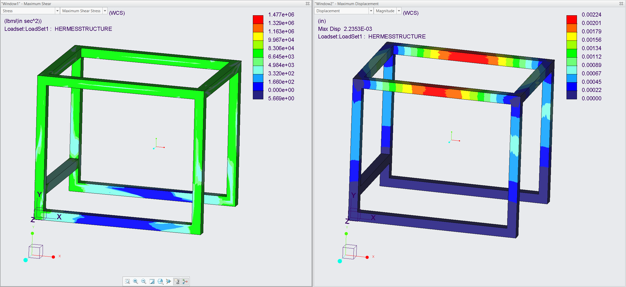


CAD and Stress Analysis
Units: psi
Units: in.
Structural frame can withstand 300 lbf
Material choice is valid
6.65 ksi < 40 ksi
Maximum Shear Stress
Magnitude of Displacement
Notes:
Conducting Finite Element Analysis (FEA), we were able to see where the stresses would occur on just the structure itself by loading it at the top and then looking at the stresses that would be present when the forks on the platform are loaded. Due to the material properties of the platform the stresses it will undergo will not cause failure when lifting the cargo package. Specifically, we looked at the maximum shear stresses, and the displacement. Brackets will help solidify the structure.

Slide 36

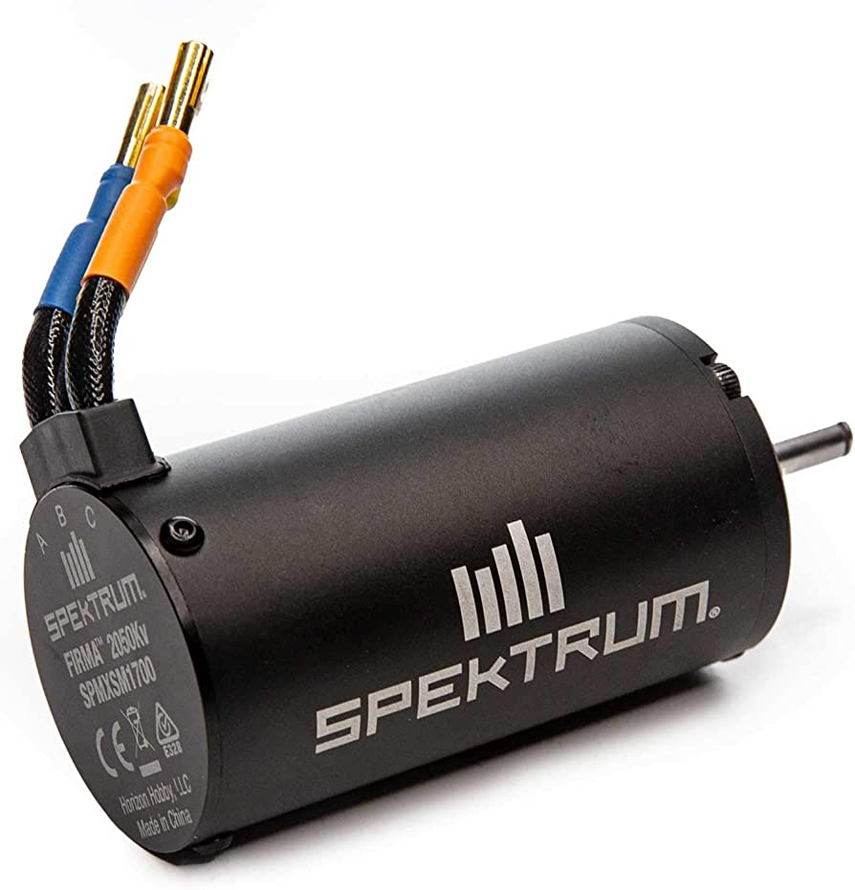
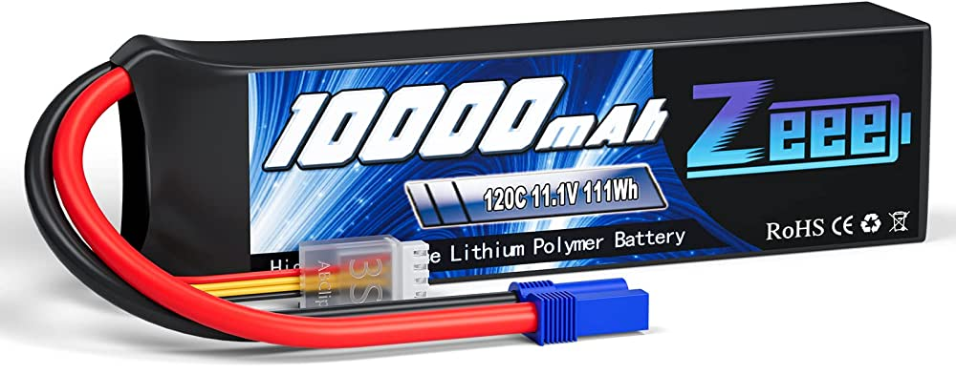
Mechatronics Design
Motor Skid Steer Subsystem
4 x
2 x
Voltage Regulator
Motor
Remote Controller
Driver
Power Source
Motor
Signal
Transducer
Signal
Receiver
Power Source
Voltage Regulator
Motor
Driver
Actuators
Motor

Slide 37
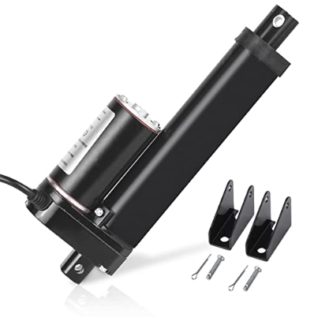

Mechatronics Design
Actuator Subsystem
4 x
Motors
Actuator
Signal
Transducer
Signal
Receiver
Power Source
Actuator
Remote Controller
Power Source
Actuator
2 x
Actuator

Slide 38




Building Structure
Up Next:
Attaching the Linear Actuators
Attaching the Power System and Wheels
Welding the Platform
Notes:
Conducting Finite Element Analysis (FEA), we were able to see where the stresses would occur on just the structure itself by loading it at the top and then looking at the stresses that would be present when the forks on the platform are loaded. Due to the material properties of the platform the stresses it will undergo will not cause failure when lifting the cargo package. Specifically, we looked at the maximum shear stresses, and the displacement. Brackets will help solidify the structure.

Slide 39




Testing and Validation
Sand Pit Testing
Variable Loads
75 %
Linear Actuator Height
140 kg
50 %
105 kg
70 kg
Notes:
Regarding testing and validation, a testing rig will be used to ensure the device can effectively handle uneven terrain and a ramp will be included to ensure it meets the critical target of traversing an incline of 20 degrees. Variable loads will be used to test the ability of the device to lift and transport various weights. To assess the linear actuator height, we will be measuring them at the maximum stroke distance and the shortest distance to ensure that the package can be loaded and unloaded successfully.

Slide 40




Budget Breakdown
Remaining
Budget
Structural
Elements
Miscellaneous
Electrical
Components

Slide 41
Budget Breakdown
Total Budget - $ 2000.00
Structural Elements - $ 451.85
Mechatronic Elements - $ 1151.00
Miscellaneous - $ 71.60
Remaining Budget - $ 325.59

Slide 42
Future Work and Timeline
Electrical Components Working as Desired
MSFC Visit and Presentation
Senior Design Day
Feb. 27th
Mar. 31st
Feb. 23rd
Mar. 14th
Apr. 6th
Mechanical Assembly and Packaging Finished
Testing Performed and Results Analyzed
Notes:
Looking ahead, outside of the current assignments, these are the next steps we are looking into completing. Having all of the parts order by the end of the month, solidifying our packaging design, completing the assembly by the end of February and in March having our electrical components like the linear actuated platform working and completing testing and analyzing the results from it. Concluding with Senior Design Day.

Slide 43

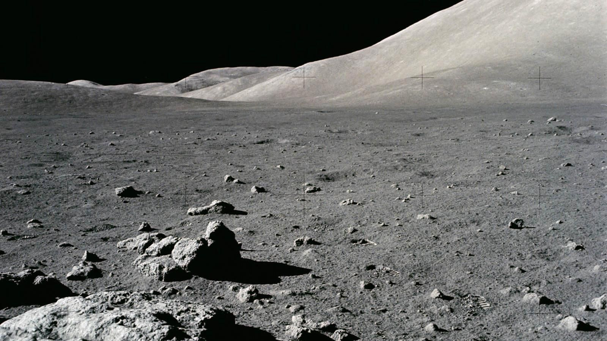




Hermes Rover
Cameron
Barnes
Cole Gutknecht
Tyler
Ince-Ingram
Rafael Meza
Michael Wyrick
Notes:
Hermes is a design that adequately addresses our key goals. The base frame can be easily adapted in the future, its lightweight, and can transport the maximum load.
We have built a CAD, The Bill of Materials, and have conducted FEA on some of the structural components of our design. I will be looking into further developing testing and validation methods to effectively meet the critical targets and we will soon look forward to finishing the assembly and testing the functionality of our device by Senior Design Day.

Slide 44
Goals
Assumptions
Targets
Lightweight
Robust
$2000 budget
Adaptable
Lifespan
Safe
Notes:
The following items are key design goals for our product. It must be lightweight; this is because reduction in weight translates to lower costs of delivery to the moon which will make our design dost effective
It must be a robust design due to challenges surrounding the lunar environment and terrain, regolith and dust can be detrimental to the design if not adequately protected.
The design should have a level of adaptability so that other necessary components such as power and thermal management systems, can be built into the design in the future
The product should last at least one year on the moon to keep transportation costs low making it cost-effective and also to decrease the amount of lunar waste that would be produced from a short-term device.
The device should meet all NASA and United States safety and technical standards and produce a relatively low risk in chance of design failure

Slide 45
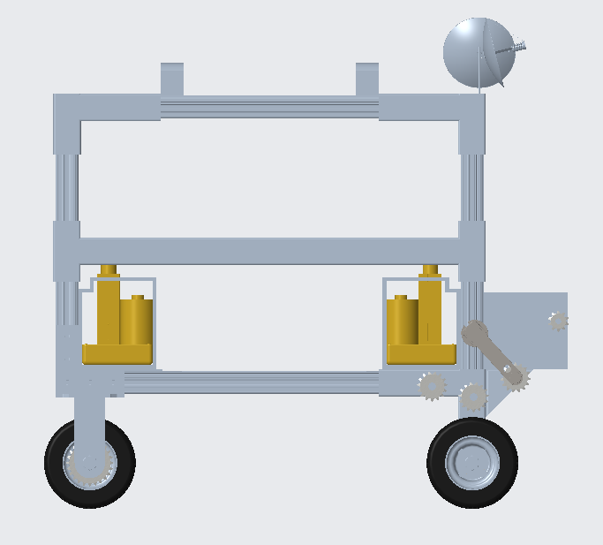
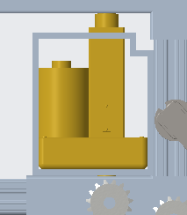

Design Iterations
Vertical Mobility
Initial
Modification
New Photo Needed
Notes:
4 linear actuators with a 4 inch stroke, will be used and placed on each corner of the platform to raise the platform 4 inches. The load capacity of the actuators will be sufficient enough since the weight would be 75 lbs per actuator. An actuator housing will be designed and manufactured by the machine shop.

Slide 46
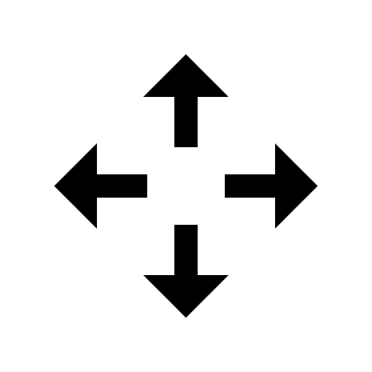
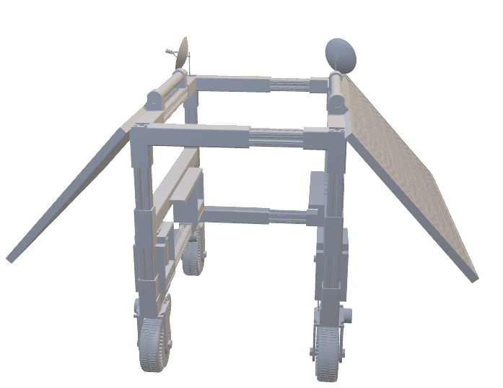
Current Design
Mechatronics
Motor
Notes:
Capable of moving at 4 km/h, gearbox will be designed with a 3:1 ratio to reduce the power required from the motors. We are still looking into different battery options.

Slide 47
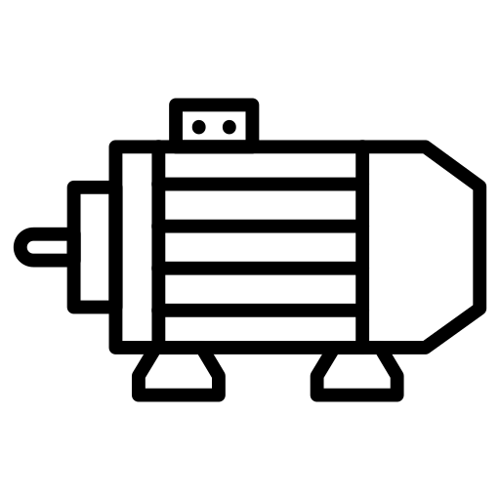
Current Work
Bill of Materials
Linear Actuators Ordered
Mechanical Components Ordered
Mechatronic Components Ordered
Ordered
Jan. 30th
Feb. 3rd
Notes:
We are currently working on making sure all our parts get ordered in a timely manner. We have ordered our linear actuators as we will need them to correctly design their housing. The Mechanical components will be ordered by the end of the month and the Mechatronic components shortly after

Slide 48
Design Review 3

Slide 50










Slide 52
MiBOX
CARGO

Slide 54
Side View
Front View

Slide 57
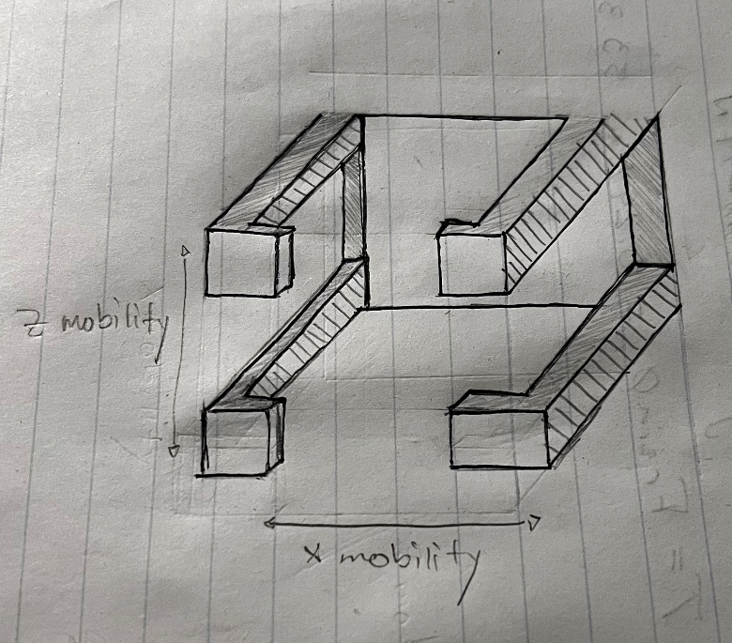

Slide 58
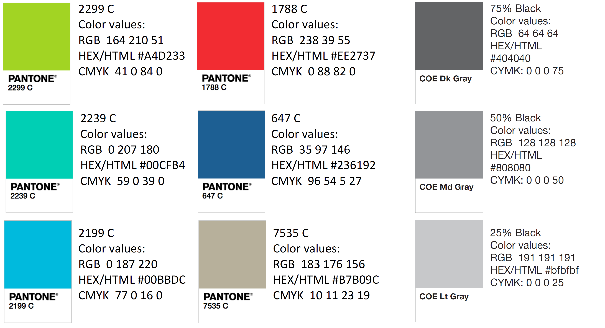
Color Palette
How do you think current control surfaces and their actuation can be improved? | Current control surfaces require clean flow, which is not realistic at high angles of attack, so that’s something. | Projectile accommodates for attached flow over control surfaces.
What draw backs come with standard fin deflections as a control surface? | Must have clean flow to actuate properly. Size and weight that come with actuation mechanism | Projectile control surfaces will be suitable effective even in detached flow.
What Mach numbers would be expected for this projectile? | FCAAP polysonic wind tunnel can’t go faster than Mach 5. We’ll probably test Mach 4. | The projectile can withstand Mach 4.
What slenderness ratio of the projectile would be appropriate? | Would be nice if it could be tied into what we have done already. Matching a baseline design here at FCAAP. 8-10 | The projectile uses a basic axisymmetric body configuration based on previously tested models.

